Slide 1
ISB 120
(Ph.D WIP, LECTURER NAME:
MULENGA MPOLOKOSO
(Ph.D_WIP, MBA, BBA, BICTED, BSCFO, TM, ISP, CMP)

Slide 2
UNIT 1: INTRODUCTION TO MICROECONOMICS
Definition and scope of microeconomics
Distinction between microeconomics and macroeconomics
Key microeconomic concepts: opportunity cost, scarcity, rational decision-making
The role of microeconomics in shaping economic policy and decision-making
Historical perspectives and the evolution of microeconomic thought
The scientific method and economic research
Microeconomics and interdisciplinary connections (e.g., psychology, sociology)
Practical applications of microeconomics in daily life
The importance of economic literacy for informed citizenship
Role of microeconomic analysis in addressing global challenges (e.g., poverty, climate change)

Slide 3
DEFINITIONS OF ECONOMICS:
Several definitions of Economics have been given. For the sake of convenience let us classify the various definitions into four groups:
1. Science of wealth
2. Science of material well-being
3. Science of choice making and
4. Science of dynamic growth and development
We shall examine each one of these briefly

Slide 4
WEALTH DEFINITION – Adam Smith
Economics as “an enquiry into the nature and causes of wealth”
MAIN FEATURES OF WEALTH DEFINITION
Economics is concerned with the study of wealth only
The term wealth denotes only material goods. Non-material goods like services and free goods are excluded
Economics studies the causes of wealth changes which means economic development
CRITICISM OF THE DEFINITION
1. Too much emphasis on wealth: Adam smith treated economics as political economy and therefore emphasised the importance of wealth from a national angle. If wealth is looked upon as money alone, it will give wrong pictures.
2. Restricted Meaning of Wealth: He defined wealth is material goods only, like table, radio, sweets etc. Non-material services of teacher, doctors are not taken as wealth.
3. Concept of Economic Man: Wealth definition was based mainly on an economic man who was supposed to give attention to economic activities only. But in reality

Slide 5
CONT…
behavior cannot be properly understood and analysed unless the other motives such as love, affection, sympathy are also given due weightage.
4. No Mention of Man’s Welfare: Wealth definition explains the wealth-getting and wealth-spending activities of man alone. It pays to attention to the importance of the welfare of the society.
5. Economic Problem: He considered the basic economic problems of meeting unlimited wants with scare means. But the central problem of economics is not at all touched by his definition.

Slide 6
WELFARE DEFINITION – ALFRED MARSHALL
Economics is a study of mankind in the ordinary business of life. It examines that part of individual and social action which is most closely connected with the attainment and with the use of the material requisites of well being”.
Economics is on the one side a study of wealth and the other important side is a part of the study of man.

Slide 7
FEATURES OF WELFARE DEFINITION
1. A study of mankind: Economics is study of mankind in the ordinary business of life that means man’s activities in the market as a producer and as a consumer of wealth.
2. A study of social actions: According to him, economics is a social science which covers the activities of an ordinary man.
3. Study of Material Welfare: He gave the primary place to man and secondary place to wealth. Moreover it does not study the whole of human welfare, but only a part of its economic or material welfare.
4. Normative Science: Welfare definition is the study of the causes affecting the material welfare. Moreover it studies the related activities concerned with wealth. Therefore he made economics as a normative study.

Slide 8
CRITICISM OF WELFARE DEFINITION
1. Material and Non-Material Welfare: Marshall has given more attention to the study of material welfare alone. The services of teacher, lawyers, singers etc, do promote welfare and such welfare may be termer as non-material welfare.
2. Objection to welfare: According to Robbins, there are certain material activities which do not promote welfare. The manufacture of wine and opium are certainly economic activities, but they are not conductive to human welfare.
3. Classificatory Definition: According to Robbins, the materialist definition is classificatory rather than analytical. Marshall definition classifies human activities into ‘economic’ and ‘non-economic’, ‘productive’ and ‘unproductive’, ‘material welfare’ and ‘non-material welfare’. And they considered only those human activities which are undertaken to promote material welfare.
4. Welfare cannot be measured: Marshall’s idea of welfare is based on cardinal utility. But utility is a psychological entity which cannot be measured.

Slide 9
SCARCITY DEFINITION – LIONEL ROBBINS
“Economics is the science which studies human behavior as a relationship between ends and scarce which have alternative uses”.

Slide 10
FUNDAMENTAL CHARACTERISTICS OF SCARCITY DEFINITION
1. Human wants are unlimited: “Ends” refers to human wants which are unlimited but the resources available to satisfy these wants are limited.
2. Scarcity: The scarcities of means resources (time or money) at the disposal of a person to satisfy his wants are limited.
3. Alternative use of scare means: Economic resources are not only scare but are also put to alternative uses that means various choice. We may use land for raising crops or for building houses.
4. The economic problem: According to him, resources are limited and it have alternative use. The choosing of one is at the cost of another.

Slide 11
CRITICISM OF SCARCITY DEFINITION
1. It is too narrow and too wide: It is too narrow because it excludes such topics as defects of economic organization which lead to idle resources. It is to wide to admit with allocation of scarce means which have alternative uses.
2. It study only positive science: Robbins study explain only about positive science which means what is it but not about what should be.
3. It confines micro analysis: It is concerned with how as individual faces unlimited ends with scare means. But economic problems are mostly social in character rater than individual.
4. Ignores growth Economics: Economics of growth and development is integral part of economics. But he does not pay any attention to these aspects of economics.
5. Not applicable to under developed countries: A peculiar feature of many under developed countries is that the resources are not scarce, but they are either underutilized or unutilized or misutilized.

Slide 12
GROWTH DEFINITION – SAMUELSON
Economics is a social science mainly concerned with the way how society employs its limited resources which have alternative uses, to produce goods and services for present and future consumption of various people or groups.

Slide 13
MAIN FEATURES OF GROWTH DEFINITION:
1. It is applicable even in a batter economy where money measurement is not possible.
2. The inclusion of time element makes the scope of economics dynamics
3. This definition possesses universality in its applications.
Note: Growth definition is similar to scarcity definition and it is an improvement over the scarcity definition.

Slide 14
DIVISION OF ECONOMICS
Consumption
Production
Exchange
Distribution
Public Finance

Slide 15
CONSUMPTION
Consumption deals with the satisfaction of human wants. There is economic activity in the world because there are wants.
When a want is satisfied, the process is known as consumption.
In this section, we study about the nature of wants, the classification of wants and some of the laws dealing with consumption such as the
law of diminishing marginal utility,
Engel’s law of family expenditure and
The law of demand.

Slide 16
PRODUCTION
Production refers to the creation of wealth. Strictly speaking, it refers to the creation of utilities.
And utility refers to the ability of a good to satisfy a want.
There are three kinds of utility. They are form utility, place utility and time utility.
Production refers to all activities which are undertaken to produce goods which satisfy human wants.
Land, labour, capital and organization are the four factors of production.

Slide 17
In the sub- division dealing with production
We study about the laws which govern the factors of production.
They include Malthusian Theory of population
The laws of returns.
We also study about the localization of industries and,
Industrial organization.

Slide 18
EXCHANGE
In modern times, no one person or country can be self-sufficient.
This gives rise to exchange. In exchange, we give one thing and take another.
Goods maybe exchanged for goods or for money.
If goods are exchanged for goods, we call it barter.
Modern economy is a money economy.
As goods are exchanged for money, we study in economics about the functions of money,
The role of banks and we also study how prices are determined. We also discuss various aspects of international trade.

Slide 19
DISTRIBUTION
Wealth is produced by the combination of land, labour, capital and organization. And it is distributed in the form rent, wages, interest and profits. In economics, we are not much interested in personal distribution. That is, we do not analyse how it is distributed among different persons in the society. But we are interested in functional distribution. As the four factors or agents of production perform different functions in production, we have to reward them.

Slide 20
PUBLIC FINANCE
Public finance deals with the economics of government.
It studies mainly about the income and expenditure of government. So we have to study about different aspects relating to
Taxation,
Public expenditure,
Public debt and so on.

Slide 21
NATURE OF ECONOMICS
The nature of economics deals with the question that whether economics falls into the category of science or arts.
Various economists have given their arguments in favour of science while
Others have their reservations for arts

Slide 22
ECONOMICS AS A SCIENCE
Science is a systematized body of knowledge which trades the relationship between cause and effect.
Robbins considered economics as a science and he explains that the last three words of economics’ indicate a clear proof that it is a science like Physics, Mathematics and Dynamics.
ARGUMENT IN FAVOUR OF ECONOMICS AS A SCIENCE
The following arguments are advanced to consider economics as a science
1. Systematized study: The scientific method of study consists of three important steps
Observation
Reasoning, and
Verification
Likewise in economics also theories have been formulated after the relevant matters are systematically collected, classified and studied.
Economics systematically divided into consumption, Production, Exchange, Distribution and Public Finance

Slide 23
ARGUMENT IN FAVOUR OF ECONOMICS AS A SCIENCE …
2. Scientific Law: A science is not a mere collection of facts, but establishes a relationship between causes and effect.
Like wise, in economics, the law of demand states that other things being equal, a fall in price of a commodity leads to an increase in demand and vice versa.
3. Experiments: In physical sciences, experiments can be conducted in laboratories,
In economics, laboratory is the economy/society in which several laws and theories can be tested.

Slide 24
ARGUMENT IN FAVOUR OF ECONOMICS AS A SCIENCE …
4. Measuring Rod of Money: According to Marshall, the measuring rod of money has conferred a special status to economics like other physical sciences.
Just as the chemist’s fine balance has made chemistry more exact than most of other physical sciences; so economics balance (money) rough and imperfect as it is, has made economics more exact than any other branch of social science’.
5. Universal: The last requirement for a science is that its laws should be universal.
In economics also, the law of demand, law of diminishing returns etc. are universal in nature.

Slide 25
ECONOMICS AS AN ART
Science is quantitative but the basis of art is qualitative.
Science is descriptive while art is suggestive.
Scientific study is impersonal and objective while art is deeply personal and subjective.
According to J.N. Keyne’s “An art is a system of rules for the attainment of given end’.
A science teaches us to know, an art teaches us to do – Luigi Cossa.
The systematic application of scientific principles is an art.

Slide 26
ECONOMICS AS AN ART…
In this view, economics is an art.
Economics provides solutions to many of the problems.
Example: the law of equi-marginal utility helps a consumer to solve his problem of getting maximum satisfaction with limited means.
The consumer surplus analysis helps a finance minister in the field of taxation.
Keyne’s Theory of employment provides a solution to unemployment.
Science requires art; art requires science, each being complementary to the other. Thus economics is both a science and an art

Slide 27
POSITIVE AND NORMATIVE APPROACHES
POSITIVE APPROACHES
NORMATIVE APPROACHES
A positive science is concerned with ‘what is’.
It explains what it is,
How it works and what its effects are.
According to Milton Friedman, positive economics deals as to how an economic problem is solved.
Robbins, Senior and Friedman are the main champions of positivism.
It simply explained cause and effect relationship.
Marshall, Fraser, wolf and Paul streeten are the main advocates of Normative science.
Normative science concerned with “what should be” or “What ought to be”
Normative science evaluates.
According to Milton Friedman, normative science deals with how economic problem should be solved.
Normative economics depends on value judgment

Slide 28
ECONOMICS IS BOTH A POSITIVE AND A NORMATIVE SCIENCE
The modern economists accept that economics is both a positive science and a normative science.
They argue that optimum utilization of the resources would not be the only aim
But also the achievement of some desirable objective such as more and just distribution of economic power and opportunities

Slide 29
SCOPE OF ECONOMICS
Economists use different economic theories to solve various economic problems in society.
Its applicability is very vast.
From a small organization to a multinational firm,
Economic laws come into play.
The scope of economics can be understood under two subheads:
Microeconomics and
Macroeconomics.

Slide 30
Microeconomics
Microeconomics examines individual economic activity, industries, and their interaction. It has the following characteristics:
Elasticity: It determines the ratio of change in the proportion of one variable to another variable. For example- the income elasticity of demand, the price elasticity of demand, the price elasticity of supply, etc.
Theory of Production: It involves an efficient conversion of input into output. For example- packaging, shipping, storing, and manufacturing.
Cost of Production: With the help of this theory, the object price is evaluated by the price of resources.
Monopoly: Under this theory, the dominance of a single entity is studied in a particular field.
Oligopoly: It corresponds to the dominance of small entities in a market

Slide 31
Macroeconomics
It is the study of an economy as a whole. It explains broad aggregates and their interactions “top down.” Macroeconomics has the following characteristics:
Growth: It studies the factors which explain economic growth such as the increase in output per capita of a country over a long period of time.
Business Cycle: This theory emerged after the Great Depression of the 1930s. It advocates the involvement of the central bank and the government to formulate monetary and fiscal policies to monitor the output over the business cycle.
Unemployment: It is measured by the unemployment rate. It is caused by various factors like rising in wages, a shortfall in vacancies, and more.
Inflation and Deflation: Inflation corresponds to an increase in the price of a commodity, while deflation corresponds to a decrease in the price of a commodity. These indicators are valuable to evaluate the status of the economy of a country

Slide 32
BRANCHES OF ECONOMICS
Microeconomics – concerned with individual markets and small aspects of the economy.
Macroeconomics – concerned with the whole aggregate economy. Issues such as inflation, economic growth and trade.

Slide 33
I MICRO ECONOMICS
1. Neo-classical economics: Key people: Leon Walrus, William Jevons, John Hicks, George Stigler and Alfred Marshall.
Neo-classical economics built on the foundations of free-market based classical economics.
It included new ideas such as Utility maximization, Rational choice theory, Marginal analysis.
Neo-classical economics is often considered to be orthodox economics.
It is the economics taught in most text-books as the starting point for economics teaching.
The tools of neo-classical economics (supply and demand, rational choice, utility maximization) can be used in new fields and also for critiques.

Slide 34
2. Development economics:
Key people: Simon Kuznets and W. Arthur Lewis, Amartya Sen and Muhammad Yunus.
Concerned with issues of poverty and under-development in poorer countries of the world.
Development economics is concerned with both micro and macro aspects of economic development.
Issues include Trade vs aid,
Increasing capital investment,
Best ways to promote economic development,
Third World debt

Slide 35
3. Environmental economics/welfare economics:
Key people: Garrett Hardin, E.F. Schumacher, Arthur Pigou.
This places greater emphasis on the environment.
This can include: Neo-classical analysis of external costs and external benefits.
From this perspective, it is rational for man to reduce pollution,
Market failures – tragedy of the commons, Public goods, external costs, external benefits,
Environmental economics can take a more radical approach – questioning whether economic growth is actually desirable.

Slide 36
4. Behavioral economics:
Key people: Gary Becker, Amos Tversky, Daniel Kahneman, Richard Thaler, Robert J. Shiller,
Behavioral economics examines the psychology behind economic decision making and economic activity.
Behavioral economics examines the limitation of the assumption individuals are perfectly rational.
It includes Bounded rationality – people make choices by rules of thumb,
Irrational exuberance – People get carried away by asset bubbles,
Nudges/Choice architecture – how the framing of decisions affects the outcome

Slide 37
Econometrics:
Key people: Jan Tinbergen
Use of data to find simple relationships.
Econometrics uses statistical methods,
Regression models and data to predict the outcome of economic policies.
For example, Okun’s law suggests a relationship between economic growth and unemployment

Slide 38
6. Labour economics:
Key people: Knut Wicksell
Concentration on wages, labour employment and labour markets.
Labour economics starts from neo-classical premise of labour supply and marginal revenue product of labour.
Recent developments in labour economics have placed greater emphasis on non-monetary factors, such as
Motivation, enjoyment and labour market imperfections.

Slide 39
II MACRO ECONOMICS
1. Classical economics: Classical economics is often considered the foundation of modern economics.
It was developed by Adam Smith, David Ricardo, Jean-Baptiste Say. Classical economics is based on
Operation of free markets. How the invisible hand and market mechanism can enable an efficient allocation of resources.
Classical economics suggests that generally, economies work most efficiently when government intervention is minimal and concerned with the protection of private property,
Promotion of free trade and limited government spending.
Classical economics does recognise that a government is needed for providing public goods, such as defense & securityII MACRO ECONOMICS
, law and order and education.

Slide 40
2. Keynesian economics:
Key people: John Maynard Keynes, Paul Samuelson.
Keynesian economics was developed in the 1930s against a backdrop of the Great Depression.
The existing economic orthodoxy was at a loss to explain the persistent economic depression and mass unemployment. Keynes suggested that markets failed to clear
For many reasons (e.g. paradox of thrift, negative multiplier, low confidence). Therefore, Keynes advocated government intervention to kick-start the economy.

Slide 41
3. Marxist economics:
Key people: Karl Marx
Emphasises unequal and unstable nature of capitalism.
Seeks a radically different approach to basic economic questions.
Rather than relying on free-market advocate state intervention in ownership, planning and distribution of resources.

Slide 42
4. Austrian economics :
Key people: Ludwig Von Mises, Carl Menger
This is another school of economics that was critical of state intervention, price controls. It is broadly free-market.
However, it criticised elements of classical school – placing greater emphasis on the individual value and actions of an individual.
For example, Austrian economists argue the value of a good reflects the marginal utility of the good – rather than the labour inputs.

Slide 43
5. Mercantilism:
Early model of economics emphasising tariff barriers and accumulation of gold reserves. Mercantilism
6. Monetarist economics: Key people: Milton Friedman, Anna Schwartz.
Monetarism was partly a reaction to the dominance of Keynesian economics in the post-war period.
Monetarists, led by Milton Friedman argued that Keynesian fiscal policy was much less effective than Keynesians suggested.

Slide 44
Monetarists
Promoted previous classical ideals, such as
Belief in the efficiency of markets.
They also placed emphasis on the control of the money supply as a way to control inflation.
Monetarist economics became influential in the 1970s and 1980s, in a period of high inflation –
Which appeared to illustrate the breakdown of the post-war consensus.

Slide 45
Basic concepts: scarcity, rationality, Choice, opportunity costs, PPF, marginal concepts, sunk costs
Scarcity
Scarcity means that resources are limited. Scarcity is sometimes considered the basic problem of economics.
Resources are scarce (limited) because we live in a world in which humans‟ wants are infinite (unlimited) but the land, labor, and capital required to satisfy those wants are limited.
This conflict between society‟s unlimited wants and our limited resources means choices must be made when deciding how to allocate scarce resources.
Scarcity is the fundamental economic problem of having seemingly unlimited human wants and needs in a world of limited resources.

Slide 46
Rationality
Rational behavior is the cornerstone of rational choice theory, a theory of economics that assumes that individuals always make decisions that provide them with the highest amount of personal utility.
These decisions provide people with the greatest benefit or satisfaction given the choices available.
A rational decision is not just a decision made by evaluating all choices, it is a decision that takes into account the reason for making the decision.
Decisions should be made taking individual and national goals into account because of scarcity.
For example, if a person chooses a job with a profile of his liking instead of a high paying job, then it would be also termed as rational behaviour.

Slide 47
Choices
Scarcity refers to the finite nature and availability of resources while choice refers to people's decisions about sharing and using those resources.
The problem of scarcity and choice lies at the very heart of economics, which is the study of how individuals and society choose to allocate scarce resources.
The scarcity of a resource in a particular context can be quantified and hence judged objectively.
Traditionally, economists have also studied people's choices over scarce resources as though they were taken through simple, objective and rational calculation.
Of course, people's decision-making is not purely rational; it is affected by emotion too. The fast-developing subfield of behavioral economics applies insights from human psychology to enrich economists‟ understanding of choice at a more subjective level

Slide 48
Opportunity Cost
This concept of scarcity leads to the idea of opportunity cost. Opportunity cost is the cost of next best alternative foregone or the value of the best alternative forgone in making any choice. In
simple terms, it is what you give up when you choose to do something else.
Every choice is a trade-off. Tradeoffs imply costs – when a decision is made, something is forgone.
For example, at university, a student may forgo the alternative uses of time spent studying and attending class instead of using the time in some other endeavor such as clubbing and playing soccer.

Slide 49
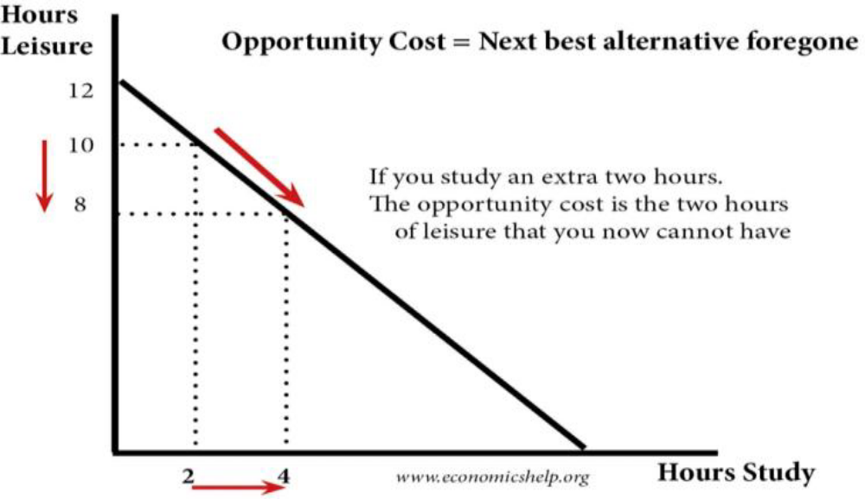
DIAGRAMATIC REPRESENTATION OF OPPORTUNITY COST

Slide 50
Production Possibilities Frontier (PPF)
The Production Possibilities Frontier (PPF) is a graph that shows all the different combinations of output of two goods that can be produced using available resources and technology.
A production possibility frontier shows how much an economy can produce given existing resources.
A production possibility can show the different choices that an economy faces.

Slide 51
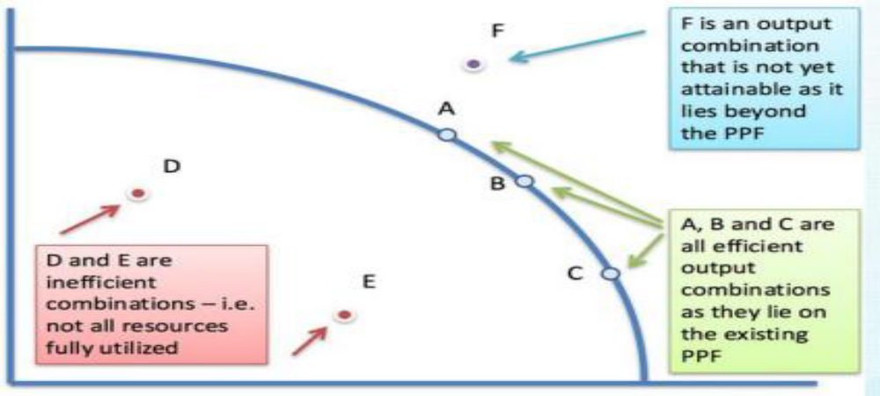
Production Possibilities Frontier (PPF)

Slide 52
CONT…
At point D, the economy is inefficient. At point D, we can increase both goods and services without any opportunity cost.
Pareto efficiency is any point on the PPF curve. On the PPF curve, it is impossible to increase one choice, without causing less production of the other.
Assumptions for PPF
Resources in an economy are fixed, but these resources can be transferred from one use to another.

Slide 53
CONT…
With the help of given resources, only two goods can be produced.
The resources are fully and efficiently utilized.
Resources are not equally efficient in production of all products. So, when resources are transferred from production of one good to another, the productivity decreases.
Marginal Concept
Marginal analysis is used in allocating scarce resources to maximize the benefit of the output produced by simply getting the most value for the resources used. The analysis of the benefits and costs of the marginal unit of a good or input (Marginal = the next unit). In any situation, people want to maximize net benefits.
Net Benefits = Total Benefits - Total Costs

Slide 54
Actors in a Market Economy: Households, Firms, Government, External Sector
The Circular Flow Model
In the products market, or the goods market, firms are the suppliers while households are the buyers.
However, in the markets for factors of production, this relationship reverses, and households become the suppliers while the firm becomes the buyer.
This relationship is illustrated in the circular flow diagram shown below.

Slide 55
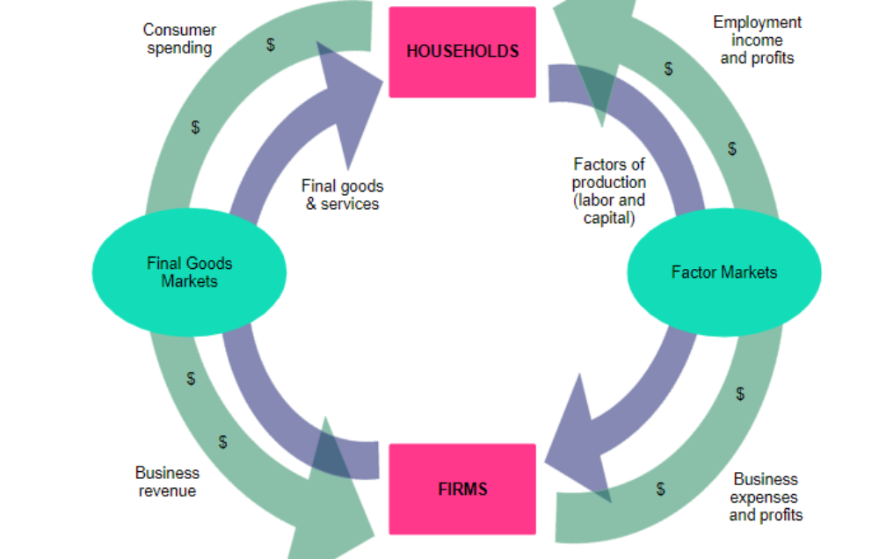
CIRCULAR FLOW DIAGRAM

Slide 56
The Complete Model
A good model to start with in economics is the circular flow diagram. Four sector model studies the circular flow in an open economy which comprises of the household sector, business sector, government sector, and foreign sector.
The foreign sector has an important role in the economy. When the domestic business firms export goods and services to the foreign markets, injections are made into the circular flow model.
On the other hand, when the domestic households, firms or the government imports something from the foreign sector, leakage occurs in the circular flow model.

Slide 57
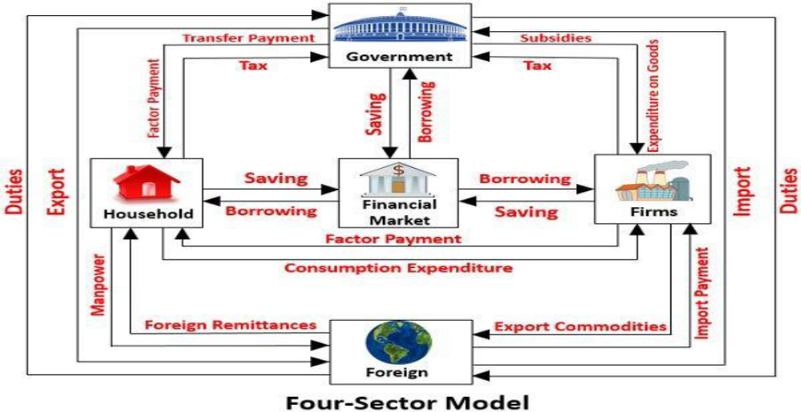
The Complete Model

Slide 58
THE CIRCULAR FLOW OF INCOME IN DIFFERENT SECTORS
From the viewpoint of the circular flow of income, each sector has dual roles to play in the economy; while a sector receives certain payments from other sectors, it pays back to those sectors as well. The circular flow of income in different sectors can be expressed as follows:
Household Sector
Receipts: The household sector receives factor income in the form of rent, wages, interest, and profit from the business sector. It also receives transfer payments from the government sector.
Payments: The income of the household sector flows into the business sector, government sector and capital markets in the form of consumption expenditure, taxes and savings respectively.

Slide 59
BUSINESS SECTOR
Receipts: The principle receipts of the business sector constitute of income from the sale of goods and services, income from exports, subsidies from the government sector, and borrowings from the capital market.
Payments: Factor payments, import payments, and savings constitute the principal payments from the business sector to the household sector, government sector, foreign sector and the capital market.
Government Sector
Receipts: The major source of income for the government sector includes the taxes paid by household and business sector. Besides this, it also receives interests and dividends for the investments made.

Slide 60
GOVERNMENT SECTOR
Receipts: The major source of income for the government sector includes the taxes paid by household and business sector. Besides this, it also receives interests and dividends for the investments made.
Payments: The government sectors make payments to different sectors in the form of transfer payments, subsidies, grants, etc.
It pays to the business sector in return for the goods purchased, makes transfer payments like pension funds, scholarships, etc. to the household sector. If the government receipts are greater than the expenses, the surplus goes to capital market.
In case of cash deficit, the government borrows from the capital market to maintain a balance in the economy.

Slide 61
FOREIGN SECTOR
Receipts: The foreign sector receives income from the business sector in return for the goods and services imported by the latter.
Payments: Foreign sectors need to make payment to the business sector from where imports have been made.
If exports exceed imports, the economy has a surplus balance of payment.
In case exports exceed imports, the economy faces a deficit balance of payment.
Depending on the trade policies, the economy tries to maintain a balance between imports and exports.

Slide 62
Practical applications of microeconomics in daily life
Price Fixation-Demand & Supply
Look at Maize Yield of 2024 and 2025
In Zambia due to drought Maize yield was low in 2024 affecting production of mealie meal and demand was still high for mealie meal hence price of a 25kg bag was too high going up-to K340 per bag
In 2025, there was plenty rain and the effect is high yield in maze, high production of mealie meal, local people have maize and stop buying mealie meal, low demand for mealie meal, low price.
War in Russia & Ukraine Have Affected Price of Major commodities like fuel, Low income countries like Zambia have been affected by increased price of fuel, unstable pricing methods, low fuel supply yet high demand.

Slide 63
Assignment Questions
1. Write on the importance of economic literacy for informed citizenship.
2. Explain The role of microeconomic analysis in addressing global challenges (e.g., poverty, climate change)
Assignment Instructions
Font & Font Size: Verdana & 12 respectively
Total No. of Pages 4. Including cover page & References
References: APA or Harvard Style
Due Date: 13th June, 2025.

